Slide 1

8th Grade: Pre-Algebra
Unit 11, Lesson 8 Barbie Bungee – Part 2 Volume 2, pg. 212

Slide 2


Benchmarks
MA.8.DP.1.1
Given a set of real-world bivariate numerical data, construct a scatter plot or a line graph as appropriate for the context.
MA.8.DP.1.2
Given a scatter plot within a real-world context, describe patterns of association.
MA.8.DP.1.3
Given a scatter plot with a linear association, informally fit a straight line.
MA.8.AR.3.5
Given a real-world context, determine and interpret the slope and 𝑦-intercept of a two-variable linear equation from a written description, a table, a graph, or an equation in slope-intercept form.
volume 2, pg. 212

Slide 3
Integrated Mathematical Thinking and Reasoning Standards
MA.K12.MTR.1.1 Actively participate in effortful learning both individually and collectively.
MA.K12.MTR.2.1 Demonstrate understanding by representing problems in multiple ways.
MA.K12.MTR.4.1 Engage in discussions that reflect on the mathematical thinking of self and others.
MA.K12.MTR.7.1 Apply mathematics to real-world contexts.
volume 2, pg. 212

Slide 4

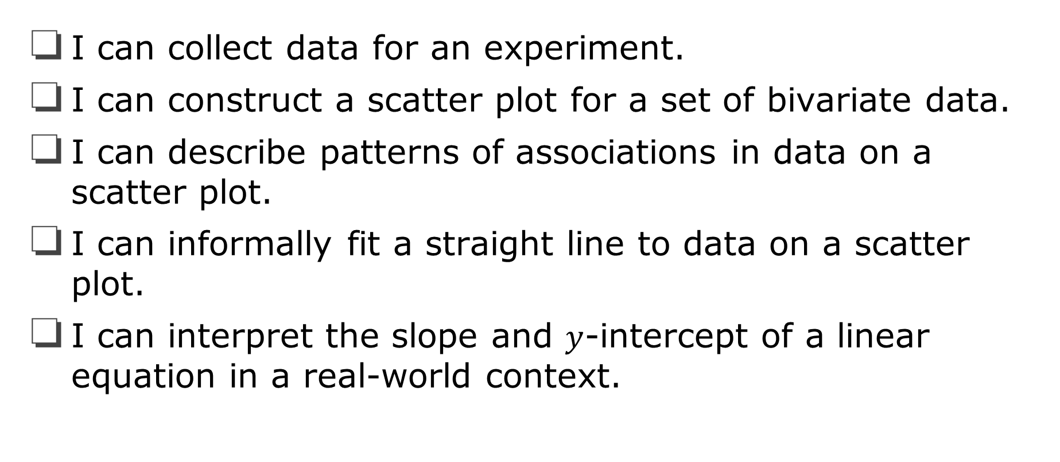
Learning Targets
I can collect data for an experiment.
I can construct a scatter plot for a set of bivariate data.
I can describe patterns of associations in data on a scatter plot.
I can informally fit a straight line to data on a scatter plot.
I can interpret the slope and $y$-intercept of a linear equation in a real-world context.
volume 2, pg. 212

Slide 5

Warm-Up
volume 2, pg. 212

Slide 6
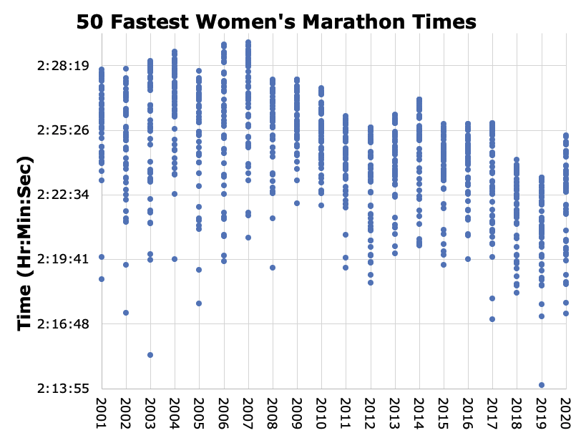
11.8.1 Warm-Up: What’s Going On in the Graph?
The graph shows the times of the $50$ fastest women’s marathoners in the world from 2001 to 2020.
volume 2, pg. 212

Slide 7
Describe how you know if the runners are getting faster or slower each year.
Give at least one possible explanation for the trend.
volume 2, pg. 212

Slide 8

Activity
volume 2, pg. 213

Slide 9

11.8.2 Activity: Barbie Bungee – Part 2
In the previous lesson, you performed an experiment and recorded the data for Barbie’s bungee experience. Work with your group to represent and analyze the data collected.
Representing and Analyzing the Data
Construct a scatter plot to represent the data collected, using the average of the trials for each number of rubber bands.
Label the axes with the appropriate variables.
Identify and label an appropriate scale for each axis on the grid.
Plot a point for each pair of values in the data set.
Title the graph.
volume 2, pg. 213

Slide 10
volume 2, pg. 213

Slide 11
Interpret the data represented on your scatter plot.
Describe the relationship between the number of rubber bands used and the jump distance.
Describe any patterns of association in the scatter plot.
volume 2, pg. 213

Slide 12
Informally fit a line to the data using a straightedge.
Discuss the following questions with your partner.
How do you think the data would change if Barbie were taller?
How do you think the data would change if Barbie were lighter?
volume 2, pg. 213

Slide 13

Bring It Together
volume 2, pg. 214

Slide 14

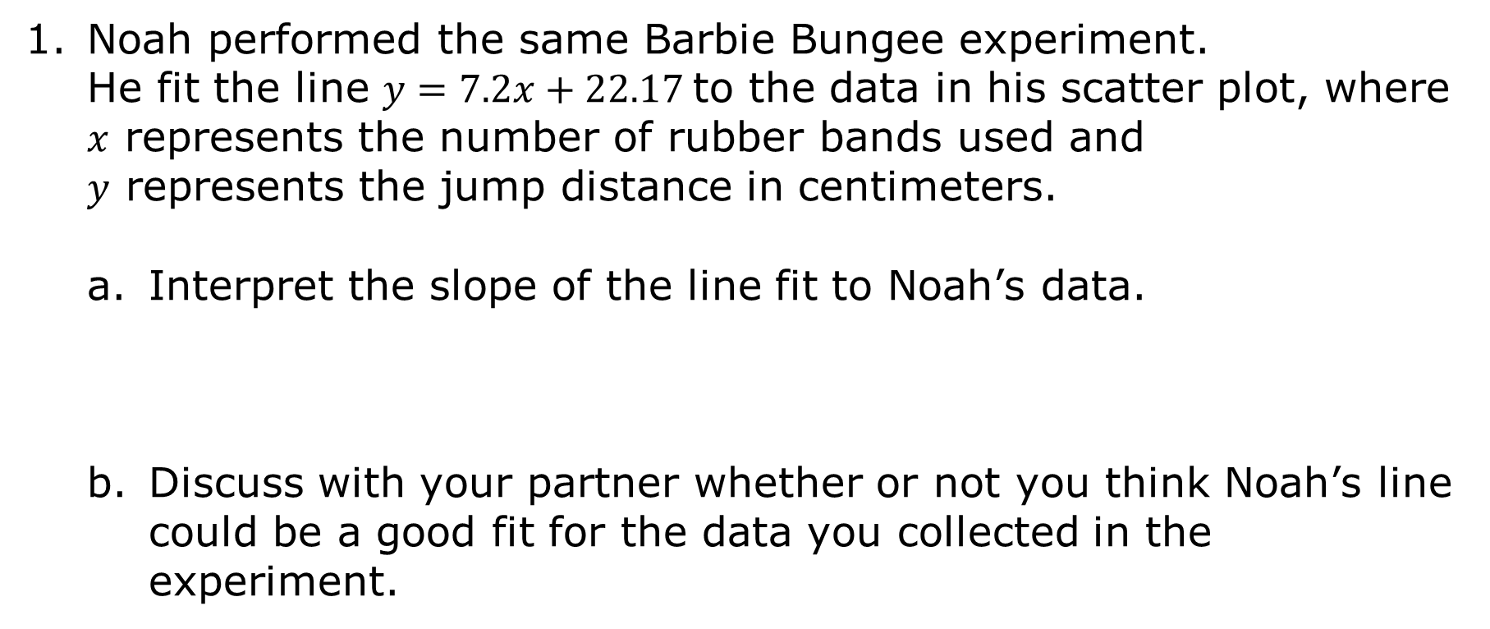
11.8.3 Bring It Together: Interpreting Data
Noah performed the same Barbie Bungee experiment. He fit the line $y=7.2x+22.17$ to the data in his scatter plot, where $x$ represents the number of rubber bands used and $y$ represents the jump distance in centimeters.
Interpret the slope of the line fit to Noah’s data.
Discuss with your partner whether or not you think Noah’s line could be a good fit for the data you collected in the experiment.
volume 2, pg. 214

Slide 15

Wrap-Up
volume 2, pg. 214

Slide 16
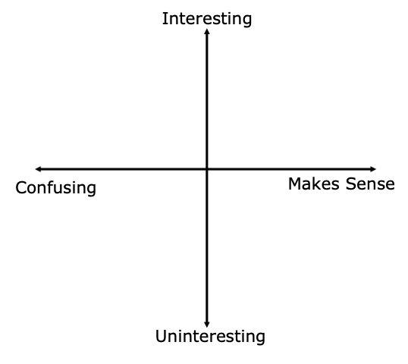
11.8.4 Wrap-Up: Reflection
Plot a point on the grid below to indicate your thoughts about the Barbie Bungee activity.
volume 2, pg. 214

Slide 17

Explain why you placed your point there.
volume 2, pg. 214

